Slide 1

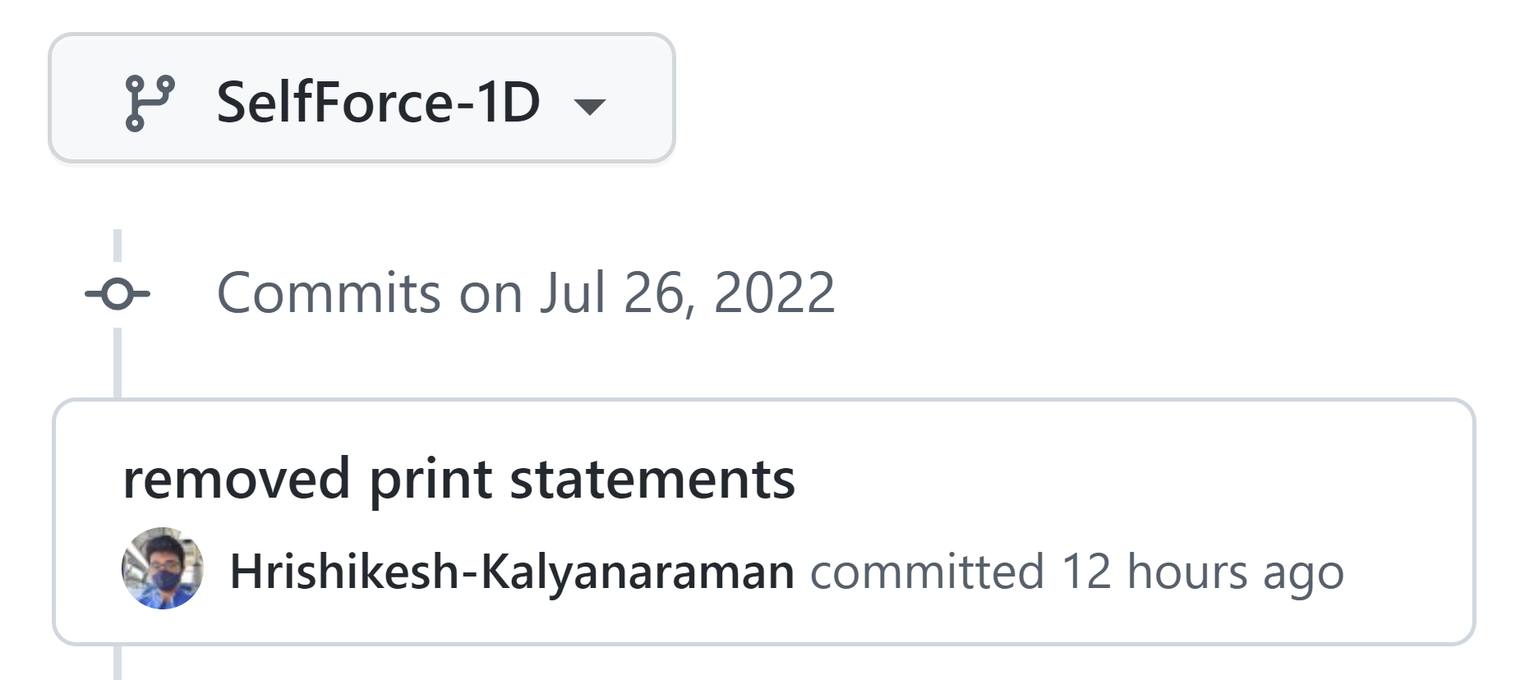
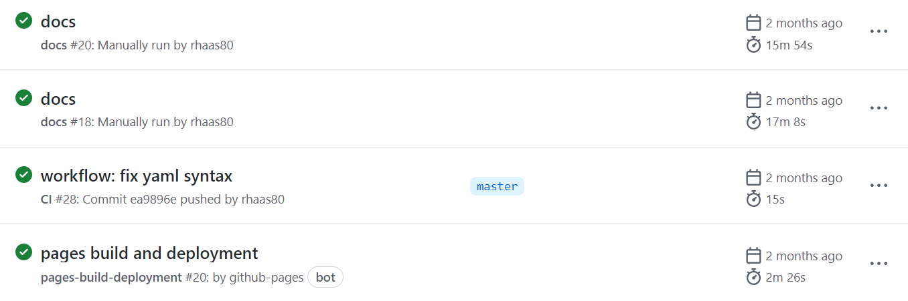
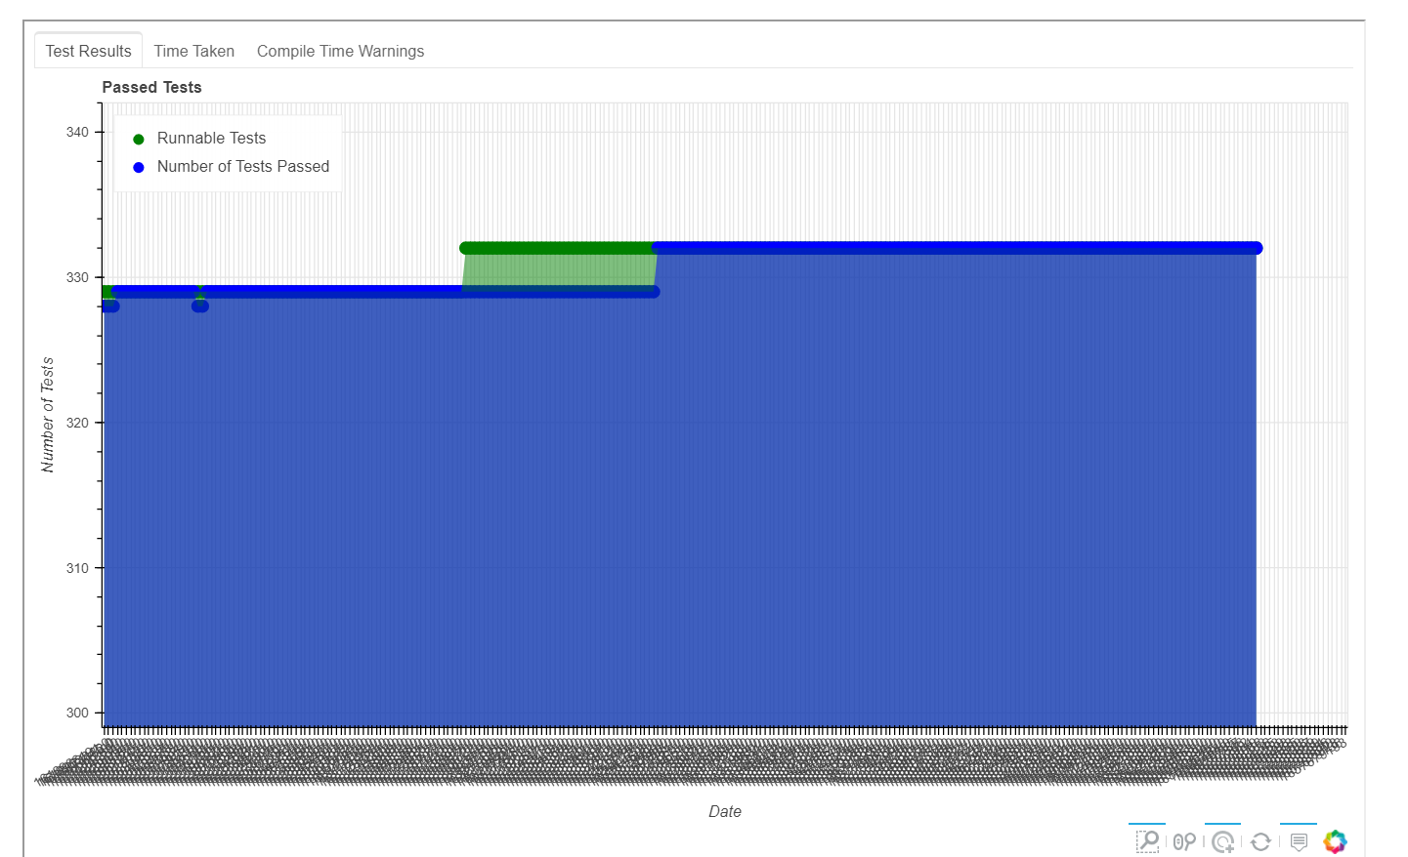
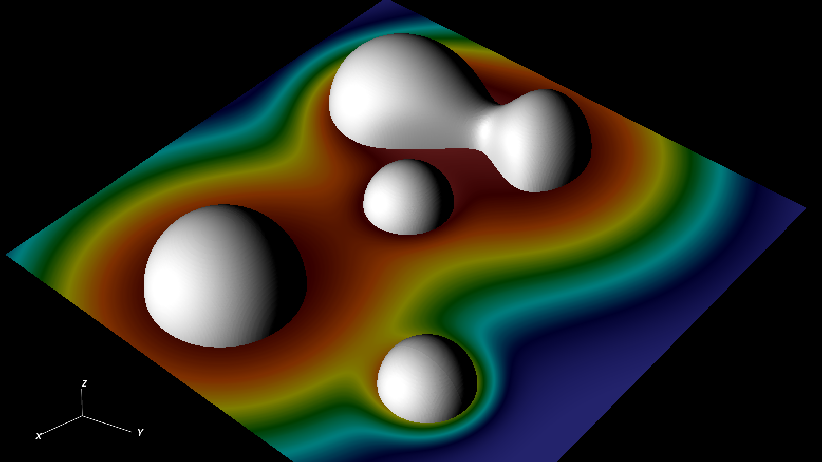
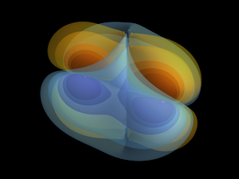
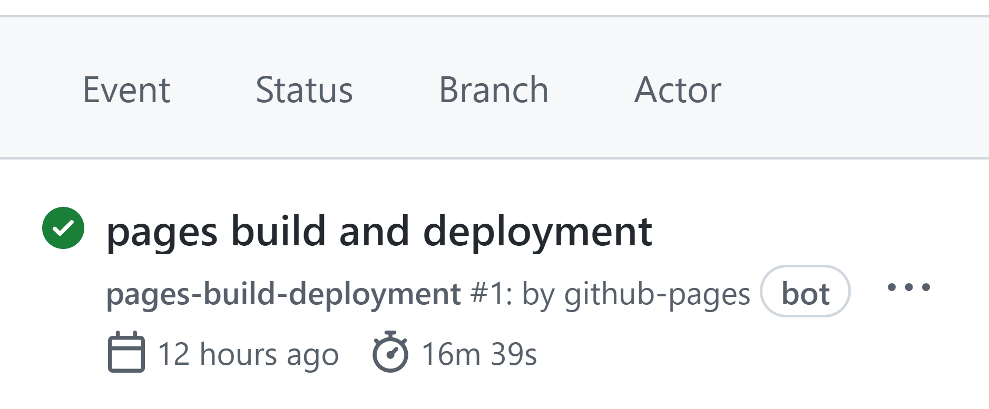
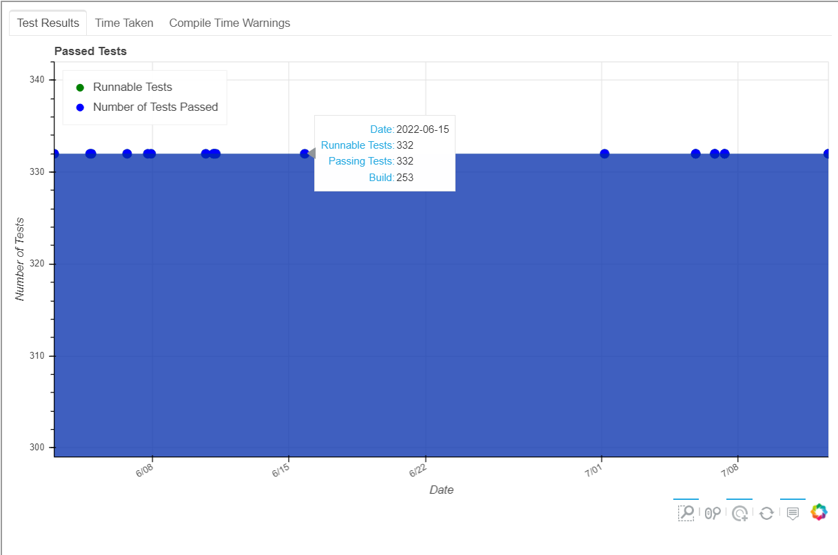
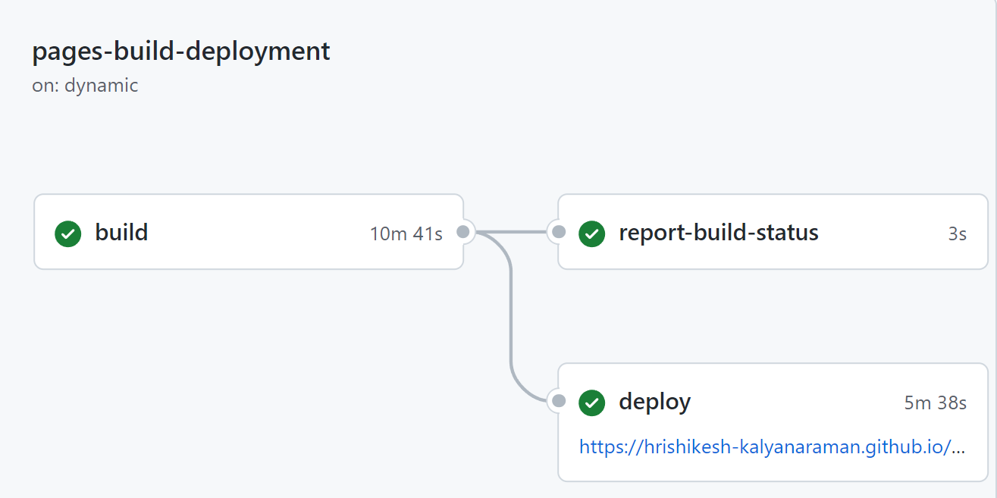
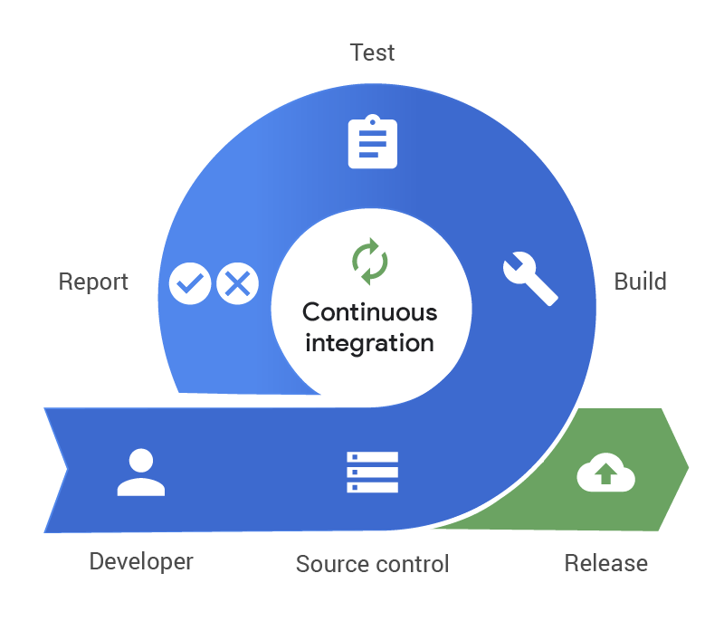
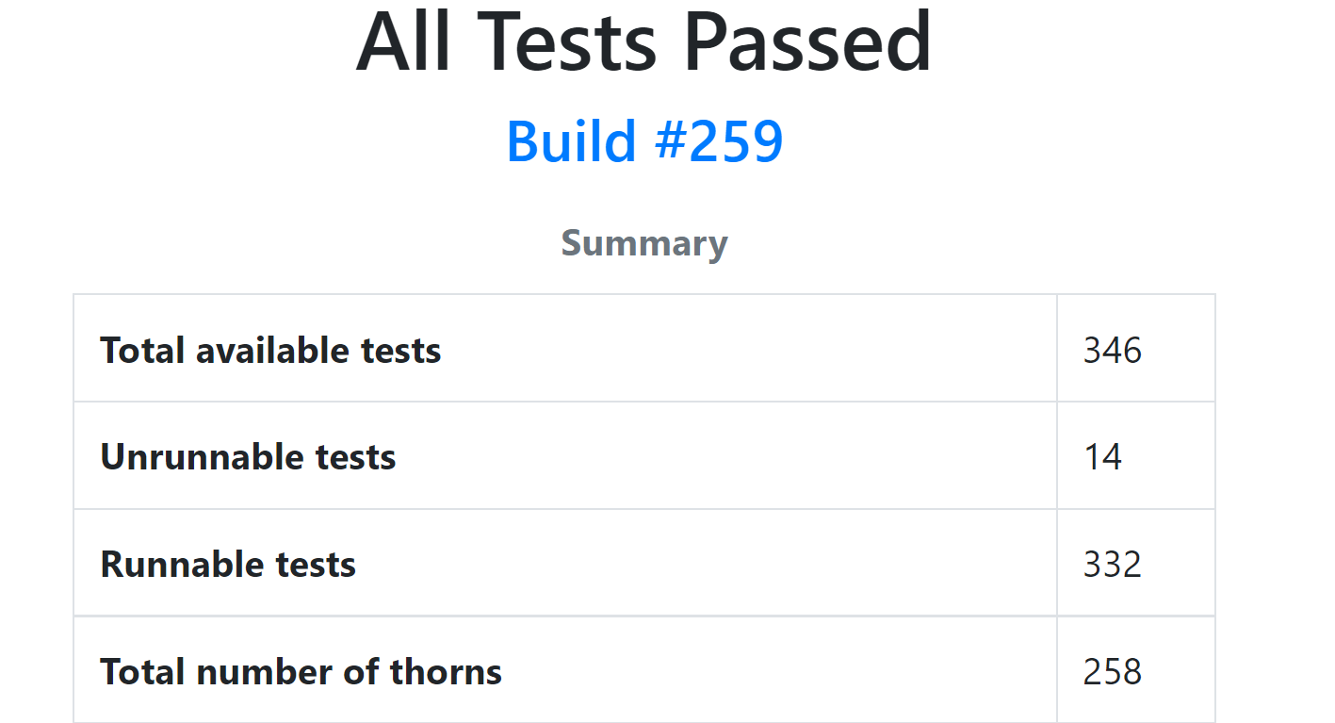

Continuous Integration Testing for the Einstein Toolkit
Hrishikesh Kalyanaraman, Mentor: Roland Haas
National Centre for Supercomputing Applications, University of Illinois at Urbana-Champaign
INTRODUCTION
The Einstein Toolkit:
Open-source, community-driven, freely accessible infrastructure for numerical relativity.
Largely composed of components from Cactus Computational Toolkit.
Contains ~ 270 modules and 300+ regression tests
Currently hosted on GitHub
Currently has 300+ users around the world.
Image of Binary Black Hole
merger by Barry Wardell.
Solving Poisson’s equations
by Eloisa Bentivegna.
Continuous Integration Testing
  A development practice that involves integrating code into a repository frequently, which is then built and tested to locate any bugs.
  Continuous Integration allows easy access to test results
  Einstein Toolkit uses GitHub Actions for Continuous Integration Testing.
METHOD
New code is “pushed” to GitHub
Continuous Integration workflow is triggered
RESULTS
FRONTEND:
HTML page UI now has improved user functionality
Redesign of interactive plots:
BACKEND:
New Python script helps automate database creation
Modified Python scripts allows SelfForce-1D into testing framework
GITHUB:
New workflow allows quicker and cheaper runs.
GITHUB ACTIONS HISTORY
FUTURE DIRECTION
Adding unit tests to existing Einstein Toolkit code
Check which existing test frameworks can be used for the Einstein Toolkit
Incorporate new code into existing setup
CONCLUSIONS
This research provides improved user access and experience when accessing automated test results. This research also develops the basis of extending current test frameworks to other code, such as Kuibit and CarpetX.
AIM
Add new workflows to GitHub
Integrate SelfForce-1D Library into existing code framework.
Improve overall HTML page design
Add additional documentation to Python code
Address issues found in prototype implementation during testing period
Image from PagerDuty showing how continuous
integration testing works
Various “jobs” (steps) of the workflow are executed
ACKNOWLEDGEMENTS
I would like to acknowledge my mentor Roland Haas, the Einstein Toolkit contributors, NCSA Gravity Group, and the NCSA SPIN Program.
The Einstein Toolkit is supported by NSF 2004157/2004044/2004311/2004879/2003893, NSF 1550551/1550461/1550436/1550514. Any opinions, findings, and conclusions or recommendations expressed in this material are those of the author(s) and do not necessarily reflect the views of the National Science Foundation.
HTML page with test results is generated and made public with GitHub-pages

